Slide 1
Persona profiles
For users interacting to the system

Slide 2

Persona 1: Irina – The Curious Parent
Demographics:
Date of Birth: February 20, 1985
Gender: Female
Location: Cluj-Napoca, Romania
Workplace: Primary school teacher
School: "Scoala Gimnaziala Nicolae Titulescu“
Technology Level: Medium (familiar with educational apps, first-time MR user)
Main Points:
Enjoys spending creative weekends with her 12-year-old son
Loves the educational potential of LEGO mixed with new technologies
Goals:
Use LEGO AR to support learning through play
Balance physical interaction and digital engagement

Slide 3
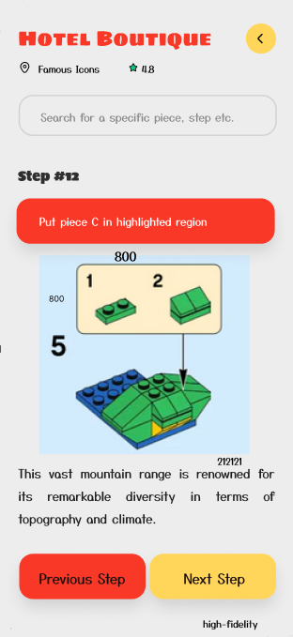
Scenarios:
User Flow Path: Main Screen → Build LEGO set → Connect MR Glasses → Use without MR glasses → Build LEGO (No MR) → LEGO Piece
Irina uses the mobile app while helping her son follow MR build instructions. She double-checks steps and encourages her son to explore AR-only content after building.
Frustrations & Pain Points:
Concerned MR glasses might be too advanced
Prefers Romanian language support in instructions
Other Details:
Strong advocate for parent-child bonding time
Likes the AR stats feature that shows remaining steps and estimated build time

Slide 4
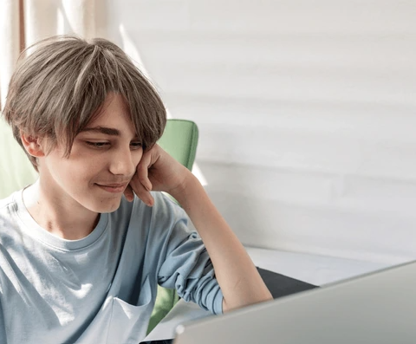
Persona 2: Vlad – The Young Tech Enthusiast
Demographics:
Date of Birth: August 12, 2009
Gender: Male
Location: Timisoara, Romania
Workplace: Student
School: "Liceul Teoretic Grigore Moisil“
Technology Level: High (familiar with VR games and mobile building apps)
Main Points:
Primary LEGO builder in the family
Unlock hidden AR features and animations
Goals:
Finish builds with minimal help
Balance physical interaction and digital engagement

Slide 5
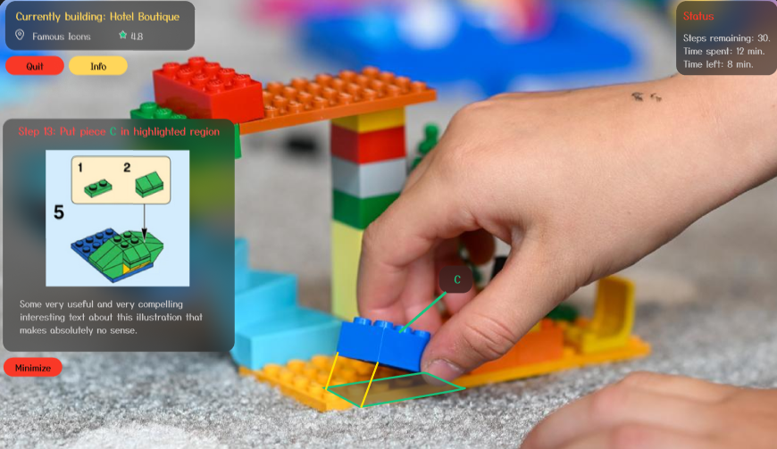
Scenarios:
User Flow Path: Main Screen → Build LEGO set → Connect MR Glasses → Finish Connection → Build LEGO (MR) → Play with LEGO (MR)
Vlad uses MR view to place bricks, checks progress via mini-map, and plays AR LEGO games after completion. Shares builds with friends.
Frustrations & Pain Points:
Gets annoyed if the MR tracking glitches
Dislikes repeated app logins or device re-pairing
Other Details:
Likes the time tracking feature, sees it as a challenge
Wants multiplayer LEGO co-op modes in AR

Slide 6

Persona 3: Doru – The Retired Hobbyist
Demographics:
Date of Birth: November 1, 1957
Gender: Male
Location: Brasov, Romania
Workplace: Retired mechanical engineer
School: “Colegiul National Unirea“
Technology Level: Low-Medium (prefers simple interfaces, dislikes headsets)
Main Points:
Loves architecture sets and nostalgic builds
Enjoys constructing sets alone, with classical music
Goals:
Stay mentally sharp and relaxed through building
Explore historical models like castles or landmarks

Slide 7
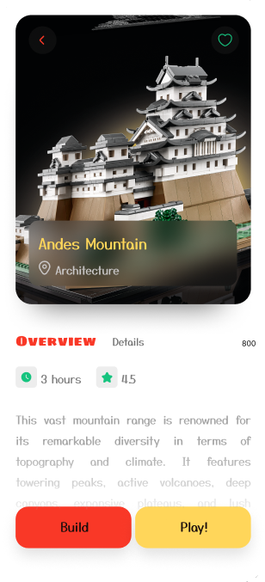
Scenarios:
User Flow Path: Main Screen → Build LEGO set → Connect MR Glasses → Use without MR glasses → Build LEGO (No MR) → LEGO Piece
Doru uses the mobile app to follow written steps, zooms into diagrams, and checks for missing parts online. Sometimes asks his granddaughter to assist with QR codes.
Frustrations & Pain Points:
UI font size too small at times
Doesn’t trust MR glasses or wearable tech
Other Details:
Appreciates clean design and no distractions
Would like a printable or exportable instruction guide

